Slide 1
Physical Layer

Slide 2
Responsibilities and Services
Provide following services to upper layer protocols:
Define network topology
Converts bit into signal and vice versa.
Defining the medium of communication
Guided Medium (Wired)
Unguided Medium (Wireless)
Defining interface type
RS232
RJ45 etc.
Facilitate parallel as well as serial communication

Slide 3
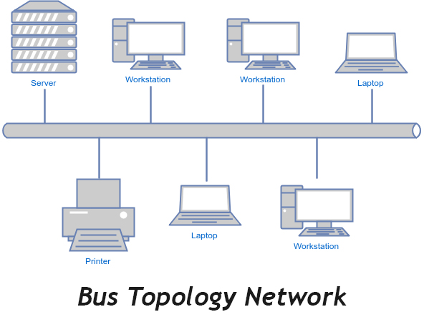
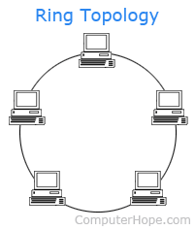
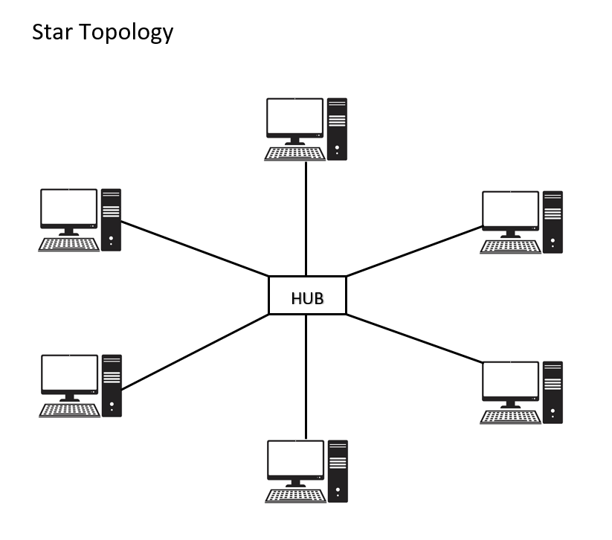
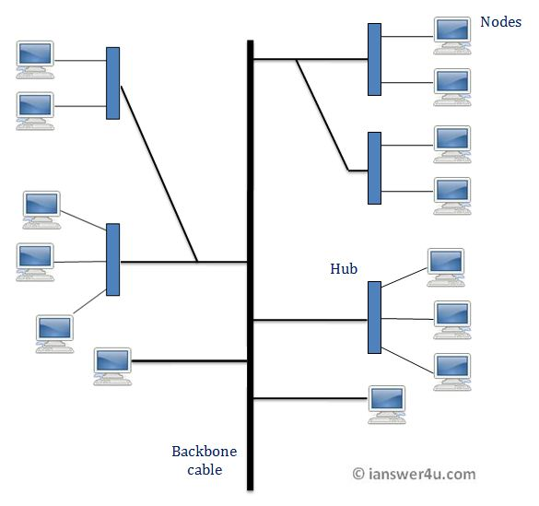

Network Topology
Bus
Ring
Star
tree
Mesh
Combination of above all

Slide 4
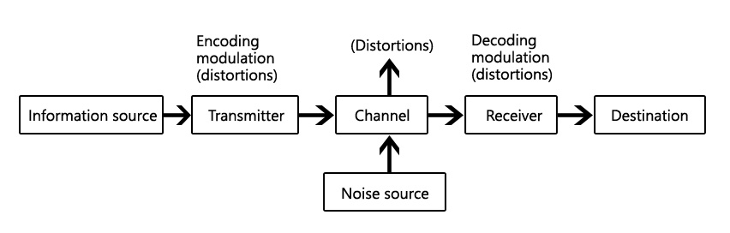
Communication Basics
Communication means transfer of data from one place to another.
To transfer the data, signals are sent from one place to another over either wired medium or wireless medium.
A signal is a physical representation of data which will be a function of time and space.

Slide 5
Communication Basics
Analog Transmission
Source
Amplifier
Amplifier
Destination
Digital Transmission
Source
Repeater
Repeater
Destination

Slide 6
Communication Channel
A logical point to point connection between source and destination.
So far we have assumed one channel per connection.
What if there is more bandwidth available than that required by a single user then we can create more than one channel from the available bandwidth by the use of multiplexing techniques for example:
Frequency division multiplexing (FDM)
Time division multiplexing (TDM)
Code division multiplexing (CDMA)
Orthogonal frequency division multiplexing (OFDM) etc.

Slide 7
Type of communication
Digital data and analog signal (Computer to internet communication through modem, mobile communication)
Digital data and digital signal (LAN)
Analog data and analog signal (Telephone)
Analog data and digital signal (Voice over internet)

Slide 8
Bandwidth vs. Spectrum
Bandwidth: it is defined for the wired medium and depends upon the number of frequencies that the medium allows to pass through it. (fmax- fmin Hz)
Spectrum: Part of electromagnetic spectrum allowed by the regulatory bodies to use.

Slide 9
Physical Layer definitions
the time required to transmit a character depends on both the encoding method and the signaling speed (i.e., the modulation rate - the number of times/sec the signal changes its voltage)
baud (D) - the number of changes per second
bandwidth (H) - the range of frequencies that is passed by a channel. The transmitted signal is constrained by the transmitter and the nature of the transmission medium in cycles/sec (hertz)
channel capacity (C) – the rate at which data can be transmitted over a given channel under given conditions.{This is also referred to as data rate (R) .}

Slide 10
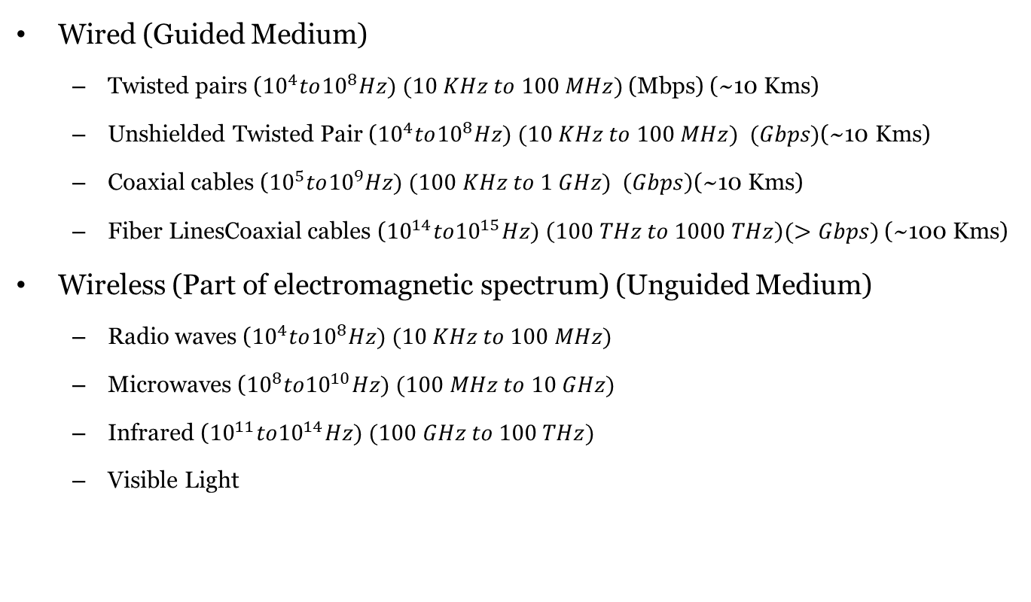
Transmission Medium
Wired (Guided Medium)
Twisted pairs (${10}^{4}to{10}^{8}Hz) (10 KHz to 100 MHz)$(Mbps) (~10 Kms)
Unshielded Twisted Pair (${10}^{4}to{10}^{8}Hz) (10 KHz to 100 MHz) (Gbps)\text{(\sim 10 }\text{Kms}\text{)}$
Coaxial cables (${10}^{5}to{10}^{9}Hz) (100 KHz to 1 GHz) \left(Gbps\right)\text{(\sim 10 }\text{Kms}\text{)}$
Fiber LinesCoaxial cables (${10}^{14}to{10}^{15}Hz) \left(100 THz to 1000 THz\right)(>Gbps)$(~100 Kms)
Wireless (Part of electromagnetic spectrum) (Unguided Medium)
Radio waves (${10}^{4}to{10}^{8}Hz) (10 KHz to 100 MHz)$
Microwaves (${10}^{8}to{10}^{10}Hz) (100 MHz to 10 GHz)$
Infrared (${10}^{11}to{10}^{14}Hz) (100 GHz to 100 THz)$
Visible Light

Slide 11
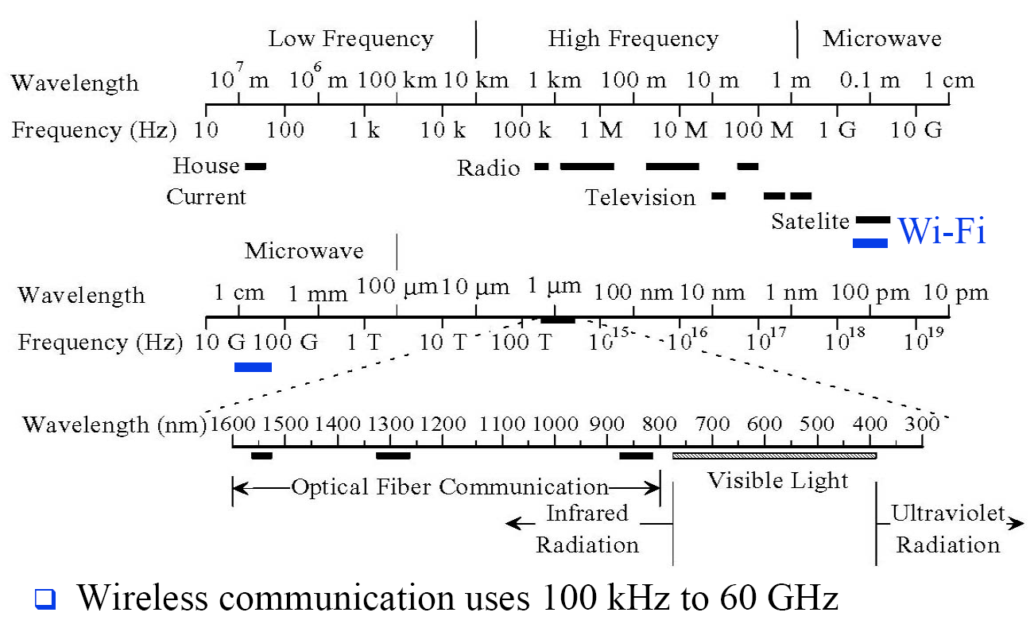
Frequencies for Communication

Slide 12
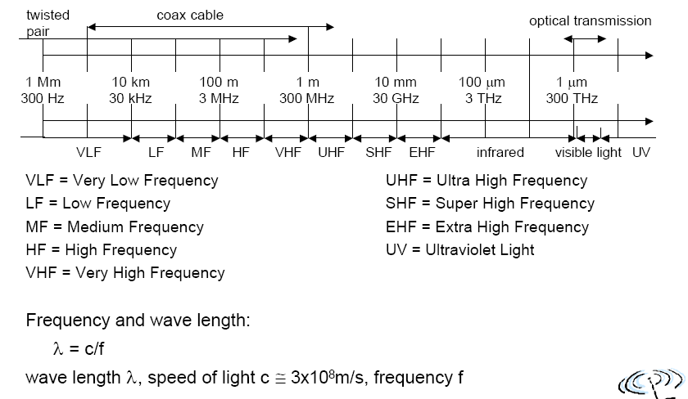
Frequencies for Communication

Slide 13
Frequencies for Communication
VLF, LF, MF HF not used for wireless
VHF-/UHF-ranges for mobile radio
simple, small antenna for cars
deterministic propagation characteristics, reliable connections
SHF and higher for directed radio links, satellite communication
small antenna, beam forming
large bandwidth available
Wireless LANs use frequencies in UHF to SHF range
some systems planned up to EHF
limitations due to absorption by water and oxygen molecules (resonance frequencies)
weather dependent fading. (E.g. signal loss caused by heavy rain)

Slide 14
What is a signal
A signal is an electrical and electromagnetic encoding of data.
Signal can be of two types:
Digital Signal (discrete time and discrete values)
Analog Signal (continuous time and continuous values)
Digital signals are generated by the use of encoding techniques.
Analog signals are generated by the use of modulation techniques.

Slide 15
Analog and Digital Signaling Comparison
Digital signaling is:
Cheaper
Less susceptible to noise interference
Suffers more attenuation.

Slide 16
Analog Transmissions
Analog transmission :: a means of transmitting analog signals without regard to their content (i.e., the signals may represent analog data or digital data).
transmissions are attenuated over distance.
Analog signal – the analog transmission system uses amplifiers to boost the energy in the signal.

Slide 17
Digital Transmissions
Digital transmissions are concerned with the content of the signal. Attenuation is overcome without amplifying the noise.
Analog signals {assumes digital data}:
With retransmission devices [analog repeater] at appropriate points the device recovers the digital data from the analog signal and generates a new clean analog signal.
the noise is not cumulative!!

Slide 18
Digital Transmissions
digital signals – digital repeaters are used to attain greater distances.
The digital repeater receives the digital signal, recovers the patterns of 0’s and 1’s and retransmits a new digital signal.
The treatment is the same for analog and digital data.

Slide 19
Signal Parameter
Parameters of periodic signals:
period T,
frequency f=1/T,
amplitude A,
phase shift θ

Slide 20
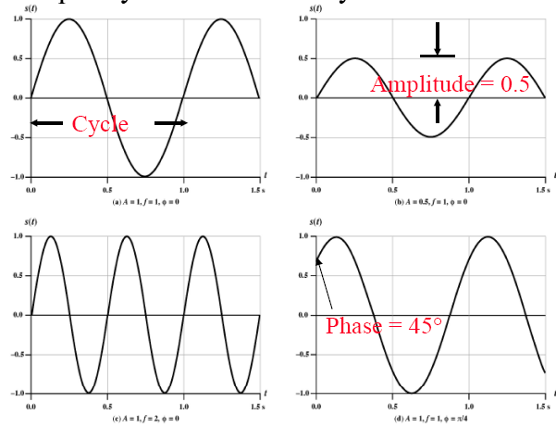
Signal Parameter (contd.)
A sine wave as special periodic signal for a carrier can be represented as:
A Sin(2πft + θ)
A = Amplitude, f=Frequency, θ= Phase, Period T = 1/f,
Frequency is measured in Cycles/sec or Hertz

Slide 21

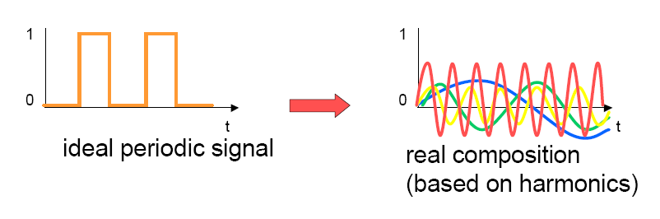
Signal Parameter (contd.)
Fourier representation of a periodic signal:

Slide 22
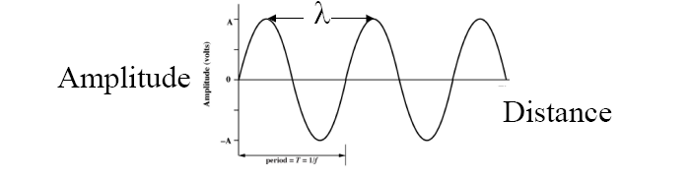
Signal Parameter (contd.)
Wavelength:
Distance occupied by one cycle
Distance between two points of corresponding phase in two consecutive cycles
Wavelength = λ
Assuming signal velocity v
(Wavelength) λ= vT
T=1/f
λf = v
λ = v/f => higher the frequency, lower the wavelength
v=c = 3×108 m/s(speed of light in free space) = 300 m/μs

Slide 23
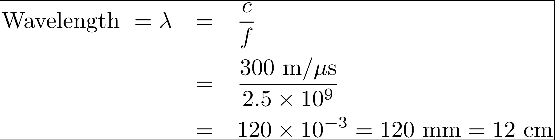
Example
Frequency = 2.5 GHz

Slide 24
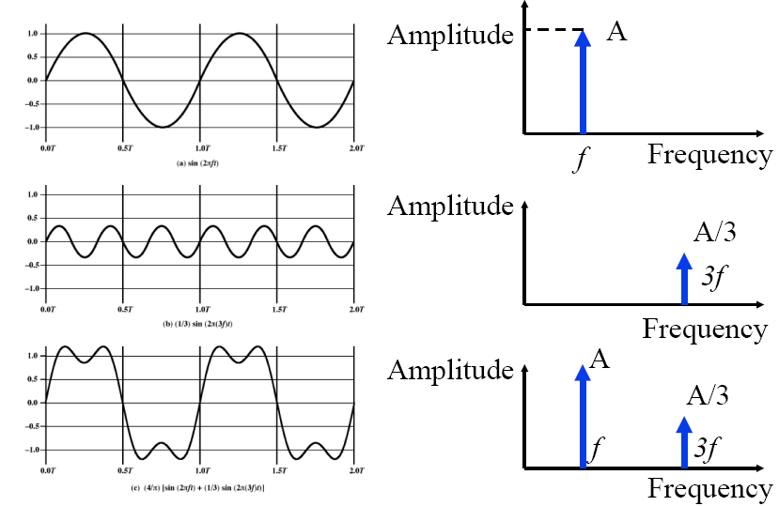
Time and Frequency Domain Representations

Slide 25
Transmission Impairments
Attenuation
Delay distortions (Delay spread)
Noise
Interference
Multipath Fading

Slide 26
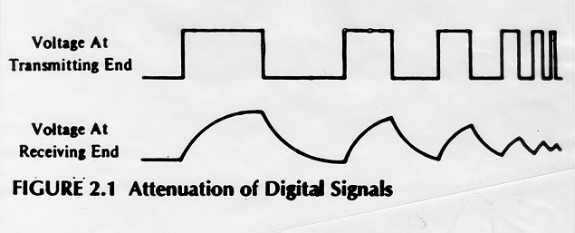

Slide 27
(a) Analog transmission: all details must be reproduced accurately
Sent
Received
e.g. AM, FM, TV transmission
(b) Digital transmission: only discrete levels need to be reproduced
Sent
Received
e.g digital telephone, CD Audio
Copyright ©2000 The McGraw Hill Companies
Leon-Garcia & Widjaja: Communication Networks
Figure 3.6

Slide 28
Nyquist Theorem {assume a noiseless channel}
If an arbitrary signal is run through a channel of bandwidth H, the signal occupy V discrete levels, then the maximum data rate obtained over the channel can be computed as
The Nyquist theorem says that the signal can be completely reconstructed by making 2H samples/sec.
Note – a higher sampling rate is pointless because higher frequency signals have been filtered out.
Max. data rate :: C = 2H log ₂ (V) bits/sec.

Slide 29
Voice-grade phone line
Example 1. {sampling rate}
H = 4000 Hz
2H = 8000 samples/sec.
➔ sample every 125 microseconds!!
Example 2. {noiseless capacity}
D = 2400 baud {note D = 2H}
V = each pulse encodes 16 levels
C = 2H log ₂ (V) = D x log ₂ (V)
= 2400 x 4 = 9600 bps.

Slide 30
Shannon’s Channel Capacity Result {assuming only thermal noise}
For a noisy channel of bandwidth H Hz. and a signal-to-noise ratio SNR, the max. data rate:
Regardless of the number of signal levels used and the frequency of the sampling.
C = H log ₂ (1 + SNR)

Slide 31

Signal to Noise Ratio
$${SNR}_{dB}=10\log_{10}{\frac{SignalPower}{NoisePower}}$$

Slide 32
Shannon Example – Noisy Channel [LG&W p. 110]
Telephone channel (3400 Hz) at 40 dB SNR
C = H log ₂ (1+SNR) b/s
SNR =40 dB ; 40 =10 log ₁₀ (SNR) ;
4 = log ₁₀ (SNR) ; SNR =10,000
C = 3400 log ₂ (10001) = 44.8 kbps

Slide 33
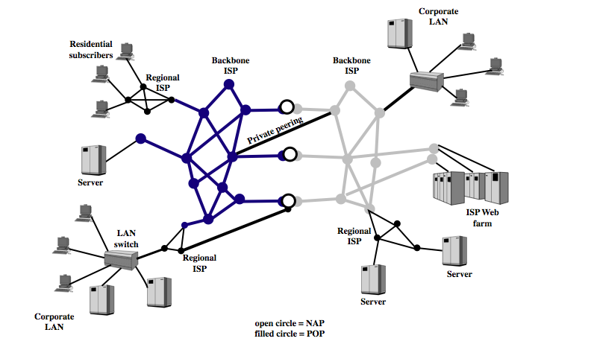
Internet Architecture

Slide 34
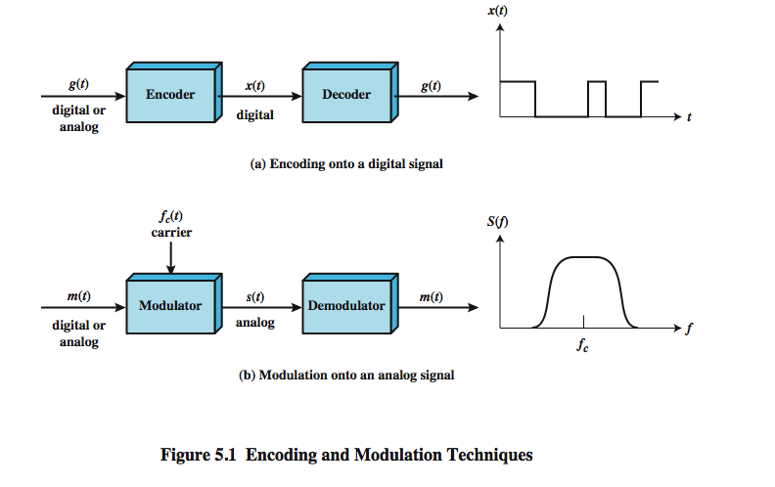
Signal Encoding Techniques
Notes:
Have already noted in Ch 3 that both analog and digital information can be encoded as either analog or digital signals:
Digital data, digital signals: simplest form of digital encoding of digital data
Digital data, analog signal: A modem converts digital data to an analog signal so that it can be transmitted over an analog
Analog data, digital signals: Analog data, such as voice and video, are often digitized to be able to use digital transmission facilities
Analog data, analog signals: Analog data are modulated by a carrier frequency to produce an analog signal in a different frequency band, which can be utilized on an analog transmission system
Stallings DCC8e Fig 5.1 emphasizes the process involved in this. For digital signaling, a data source g(t), which may be either digital or analog, is encoded into a digital signal x(t). The basis for analog signaling is a continuous constant-frequency f_{c} signal known as the carrier signal. Data may be transmitted using a carrier signal by modulation, which is the process of encoding source data onto the carrier signal. All modulation techniques involve operation on one or more of the three fundamental frequency domain parameters: amplitude, frequency, and phase. The input signal m(t) may be analog or digital and is called the modulating signal, and the result of modulating the carrier signal is called the modulated signal s(t).

Slide 35
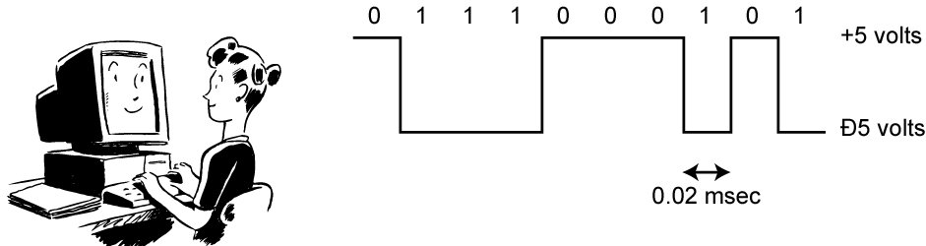
Digital Data, Digital Signal
Digital signal
discrete, discontinuous voltage pulses
each pulse is a signal element
binary data encoded into signal elements
Notes:
Encoding - Digital data to digital signals: A digital signal is a sequence of discrete, discontinuous voltage pulses, as illustrated in Stallings DCC8e Figure 3.13. Each pulse is a signal element. Binary data are transmitted by encoding each data bit into signal elements. In the simplest case, there is a one-to-one correspondence between bits and signal elements. More complex encoding schemes are used to improve performance, by altering the spectrum of the signal and providing synchronization capability. In general, the equipment for encoding digital data into a digital signal is less complex and less expensive than digital-to-analog modulation equipment

Slide 36
Comparison of Encoding Schemes
clocking
error detection
signal interference and noise immunity (BER)
cost and complexity (Hardware implementation and no. of signals required to represent 1 bit information)
Net DC Component present in the signal
Notes:
Before describing the various encoding techniques, consider the following ways of evaluating or comparing them:
Signal Spectrum - Lack of high frequencies reduces required bandwidth, lack of dc component allows ac coupling via transformer, providing isolation, should concentrate power in the middle of the bandwidth
Clocking - need for synchronizing transmitter and receiver either with an external clock or with a sync mechanism based on signal
Error detection - useful if can be built in to signal encoding
Signal interference and noise immunity - some codes are better than others
Cost and complexity - Higher signal rate (& thus data rate) lead to higher costs, some codes require signal rate greater than data rate

Slide 37
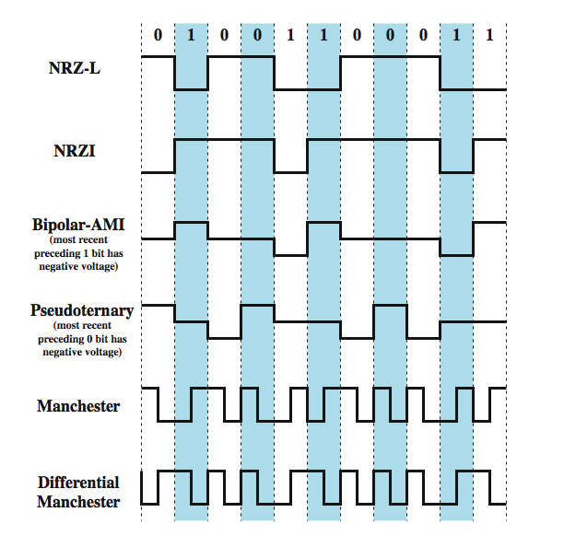
Encoding Schemes
Notes:
We now turn to a discussion of various techniques, which are defined in Stallings DCC8e Table 5.2 and depicted in Figure 5.2 as shown above. They include:
Nonreturn to Zero-Level (NRZ-L)
Nonreturn to Zero Inverted (NRZI)
Bipolar -AMI
Pseudoternary
Manchester
Differential Manchester
B8ZS
HDB3

Slide 38
Nonreturn to Zero-Level (NRZ-L)
two different voltages for 0 and 1 bits
Rule
0: High voltage level
1: Low voltage level
Data stream: 0 0 0 0 1 0 1 0 1 1 1 0 1 0
Notes:
The most common, and easiest, way to transmit digital signals is to use two different voltage levels for the two binary digits. Codes that follow this strategy share the property that the voltage level is constant during a bit interval; there is no transition (no return to a zero voltage level). Can have absence of voltage used to represent binary 0, with a constant positive voltage used to represent binary 1. More commonly a negative voltage represents one binary value and a positive voltage represents the other. This is known as Nonreturn to Zero-Level (NRZ-L). NRZ-L is typically the code used to generate or interpret digital data by terminals and other devices.

Slide 39
No Return to Zero Inverted (Differential Encoding)
no return to zero inverted on ones
constant voltage pulse for duration of bit
data encoded as presence or absence of signal transition at beginning of bit time
1: transition (low to high or high to low) at the start of the bit interval
0:no transition at the start of the bit interval
Data stream: 0 0 0 0 1 0 1 0 1 1 1 0 1 0
Notes:
A variation of NRZ is known as NRZI (Nonreturn to Zero, invert on ones). As with NRZ-L, NRZI maintains a constant voltage pulse for the duration of a bit time. The data bits are encoded as the presence or absence of a signal transition at the beginning of the bit time. A transition (low to high or high to low) at the beginning of a bit time denotes a binary 1 for that bit time; no transition indicates a binary 0.
NRZI is an example of differential encoding. In differential encoding, the information to be transmitted is represented in terms of the changes between successive signal elements rather than the signal elements themselves. The encoding of the current bit is determined as follows: if the current bit is a binary 0, then the current bit is encoded with the same signal as the preceding bit; if the current bit is a binary 1, then the current bit is encoded with a different signal than the preceding bit. One benefit of differential encoding is that it may be more reliable to detect a transition in the presence of noise than to compare a value to a threshold. Another benefit is that with a complex transmission layout, it is easy to lose the sense of the polarity of the signal.

Slide 40
NRZ Pros & Cons
Pros
easy to engineer
make good use of bandwidth
Cons
dc component
lack of synchronization capability
used for magnetic recording
not often used for signal transmission
Notes:
The NRZ codes are the easiest to engineer and, in addition, make efficient use of bandwidth. Most of the energy in NRZ and NRZI signals is between dc and half the bit rate. The main limitations of NRZ signals are the presence of a dc component and the lack of synchronization capability. Consider that with a long string of 1s or 0s for NRZ-L or a long string of 0s for NRZI, the output is a constant voltage over a long period of time. Under these circumstances, any drift between the clocks of transmitter and receiver will result in loss of synchronization between the two.
Because of their simplicity and relatively low frequency response characteristics, NRZ codes are commonly used for digital magnetic recording. However, their limitations make these codes unattractive for signal transmission applications.

Slide 41
Multilevel Binary Bipolar-AMI
Use more than two levels
Bipolar-AMI
0: represented by no line signal (0 Voltage)
1: one represented by alternate positive and negative pulse
Data stream: 0 0 0 0 1 0 1 0 1 1 1 0 0 0 0 0 0 0 0 0 0 0
Pros:
no loss of sync if a long string of ones
long runs of zeros still a problem
no net dc component
lower bandwidth
easy error detection
Notes:
A category of encoding techniques known as multilevel binary addresses some of the deficiencies of the NRZ codes. These codes use more than two signal levels. Two examples of this scheme was illustrated in Figure 5.2.
In the bipolar-AMI scheme, a binary 0 is represented by no line signal, and a binary 1 is represented by a positive or negative pulse. The binary 1 pulses must alternate in polarity. There are several advantages to this approach. First, there will be no loss of synchronization if a long string of 1s occurs. Each 1 introduces a transition, and the receiver can resynchronize on that transition. A long string of 0s would still be a problem. Second, because the 1 signals alternate in voltage from positive to negative, there is no net dc component. Also, the bandwidth of the resulting signal is considerably less than the bandwidth for NRZ. Finally, the pulse alternation property provides a simple means of error detection. Any isolated error, whether it deletes a pulse or adds a pulse, causes a violation of this property.

Slide 42
Multilevel Binary Pseudoternary
Same as Bipolar – AMI
1: represented by no line signal (0 Voltage)
0: one represented by alternate positive and negative pulse
Data stream: 0 0 0 0 1 0 1 0 1 1 1 0 0 0 0 0 0 0 0 0 0 0
Both Bipolar AMI and Pseudoternary used in some applications.
Notes:
The comments on bipolar-AMI also apply to pseudoternary. In this case, it is the binary 1 that is represented by the absence of a line signal, and the binary 0 by alternating positive and negative pulses. There is no particular advantage of one technique versus the other, and each is the basis of some applications.

Slide 43
Multilevel Binary Issues
synchronization with long runs of 0’s or 1’s
not as efficient as NRZ
each signal element only represents one bit
receiver distinguishes between three levels: +A, -A, 0
a 3 level system could represent log₂3 = 1.58 bits
requires approx. 3dB more signal power for same probability of bit error
Examples:
Manchester and
Differential Manchester Encoding
Notes:
Although a degree of synchronization is provided with these codes, a long string of 0s in the case of AMI or 1s in the case of pseudoternary still presents a problem. Several techniques have been used to address this deficiency. One approach is to insert additional bits that force transitions. This technique is used in ISDN (integrated services digital network) for relatively low data rate transmission. Of course, at a high data rate, this scheme is expensive, because it results in an increase in an already high signal transmission rate. To deal with this problem at high data rates, a technique that involves scrambling the data is used.
Thus, with suitable modification, multilevel binary schemes overcome the problems of NRZ codes. Of course, as with any engineering design decision, there is a tradeoff. With multilevel binary coding, the line signal may take on one of three levels, but each signal element, which could represent log₂ 3 = 1.58 bits of information, bears only one bit of information, since the receiver of multilevel binary signals has to distinguish between three levels (+A, –A, 0) instead of just two levels in the signaling formats previously discussed. Because of this, the multilevel binary signal requires approximately 3 dB more signal power than a two-valued signal for the same probability of bit error. Put another way, the bit error rate for NRZ codes, at a given signal-to-noise ratio, is significantly less than that for multilevel binary.

Slide 44
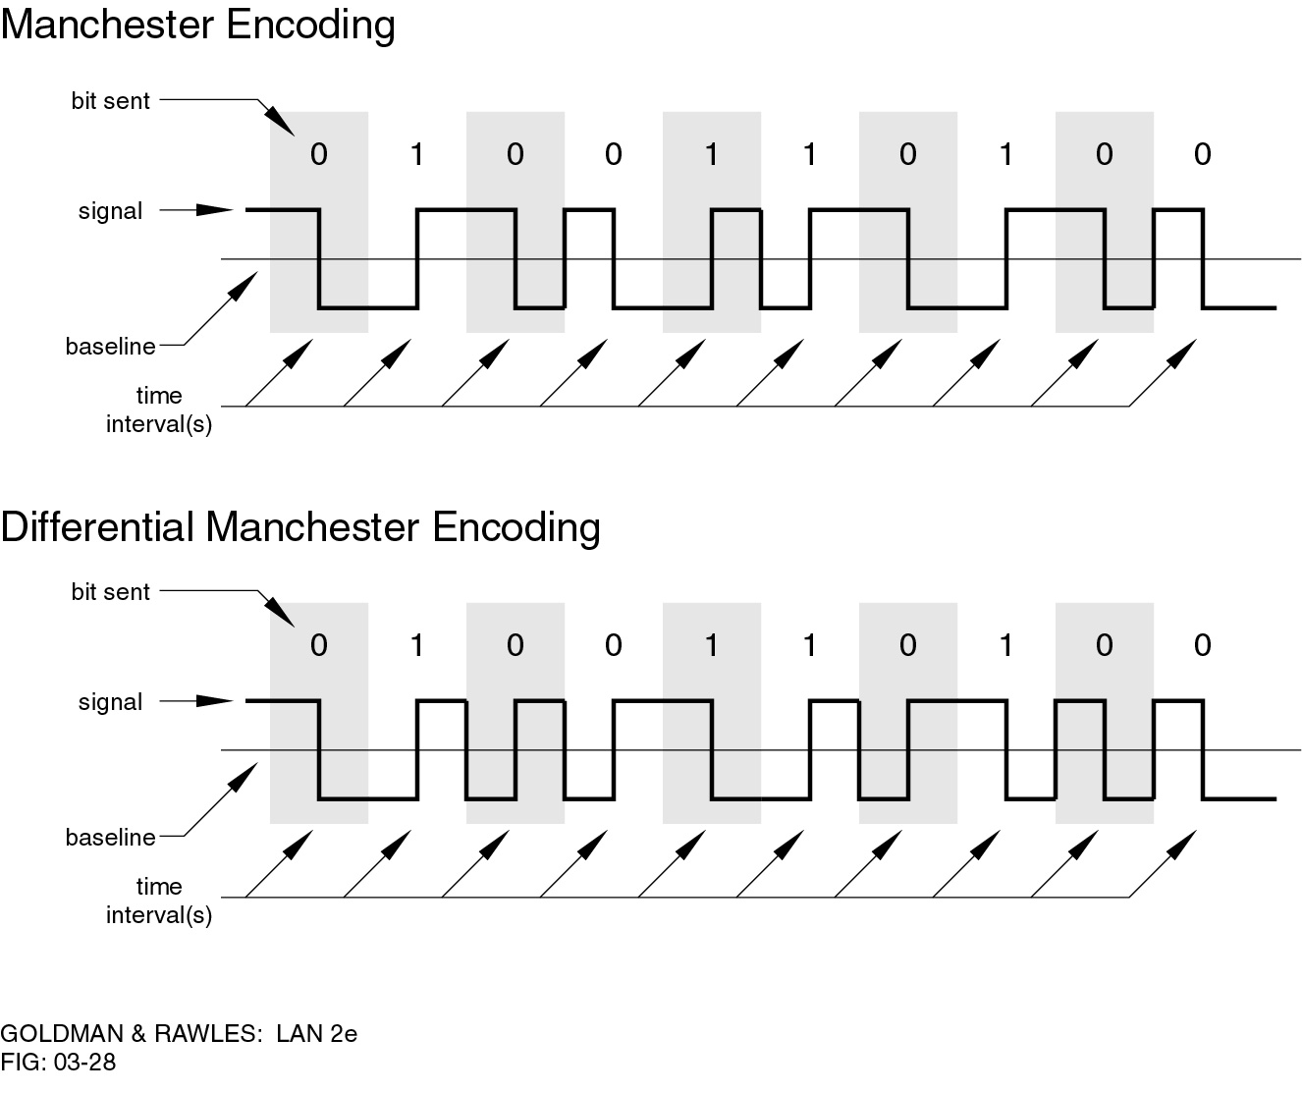
Manchester Encoding
Rule
has transition in middle of each bit period
transition serves as clock and data
1: Low to high transition at the middle of the bit interval
0: High to low transition at the middle of the bit interval
used by IEEE 802.3 (Ethernet)
Notes:
There is another set of coding techniques, grouped under the term biphase, that overcomes the limitations of NRZ codes. Two of these techniques, Manchester and differential Manchester, are in common use.
In the Manchester code, there is a transition at the middle of each bit period. The midbit transition serves as a clocking mechanism and also as data: a low-to-high transition represents a 1, and a high-to-low transition represents a 0. Biphase codes are popular techniques for data transmission. The more common Manchester code has been specified for the IEEE 802.3 (Ethernet) standard for baseband coaxial cable and twisted-pair bus LANs.

Slide 45
Differential Manchester Encoding
Rule
0: transition at start of bit period
1: no transition at start of bit period
Always a transition at the middle of bit interval is clocking only
this is a differential encoding scheme
used by IEEE 802.5
Notes:
In differential Manchester, the midbit transition is used only to provide clocking. The encoding of a 0 is represented by the presence of a transition at the beginning of a bit period, and a 1 is represented by the absence of a transition at the beginning of a bit period. Differential Manchester has the added advantage of employing differential encoding.
Differential Manchester has been specified for the IEEE 802.5 token ring LAN, using shielded twisted pair.

Slide 46
Biphase Pros and Cons
Con
at least one transition per bit time and possibly two
maximum modulation rate is twice NRZ
requires more bandwidth
Pros
synchronization on mid bit transition (self clocking)
has no dc component
has error detection
Notes:
All of the biphase techniques require at least one transition per bit time and may have as many as two transitions. Thus, the maximum modulation rate is twice that for NRZ; this means that the bandwidth required is correspondingly greater. The bandwidth for biphase codes is reasonably narrow and contains no dc component. However, it is wider than the bandwidth for the multilevel binary codes.
On the other hand, the biphase schemes have several advantages:
• Synchronization: Because there is a predictable transition during each bit time, the receiver can synchronize on that transition, known as self-clocking codes.
• No dc component: Biphase codes have no dc component
• Error detection: The absence of an expected transition can be used to detect errors. Noise on the line would have to invert both the signal before and after the expected transition to cause an undetected error.

Slide 47
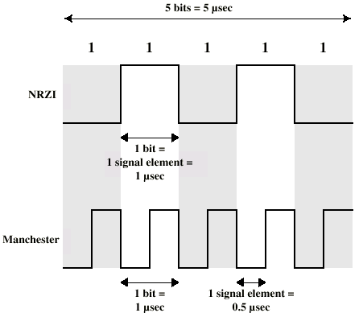
Modulation Rate
Notes:
When signal-encoding techniques are used, a distinction needs to be made between data rate (expressed in bits per second) and modulation rate (expressed in baud). The data rate, or bit rate, is 1/T_{b}, where T_{b} = bit duration. The modulation rate is the rate at which signal elements are generated. Consider, for example, Manchester encoding. The minimum size signal element is a pulse of one-half the duration of a bit interval. For a string of all binary zeroes or all binary ones, a continuous stream of such pulses is generated. Hence the maximum modulation rate for Manchester is 2/T_{b}. This situation is illustrated in Stallings DCC8e Figure 5.5, which shows the transmission of a stream of binary 1s at a data rate of 1 Mbps using NRZI and Manchester.
One way of characterizing the modulation rate is to determine the average number of transitions that occur per bit time. In general, this will depend on the exact sequence of bits being transmitted. Stallings DCC8e Table 5.3 compares transition rates for various techniques.

Slide 48
For long distance digital transmission
Bipolar AMI with 8 zero substitution (B8ZS)
High Density Bipolar with 4 zero substitution (HDB3)

Slide 49
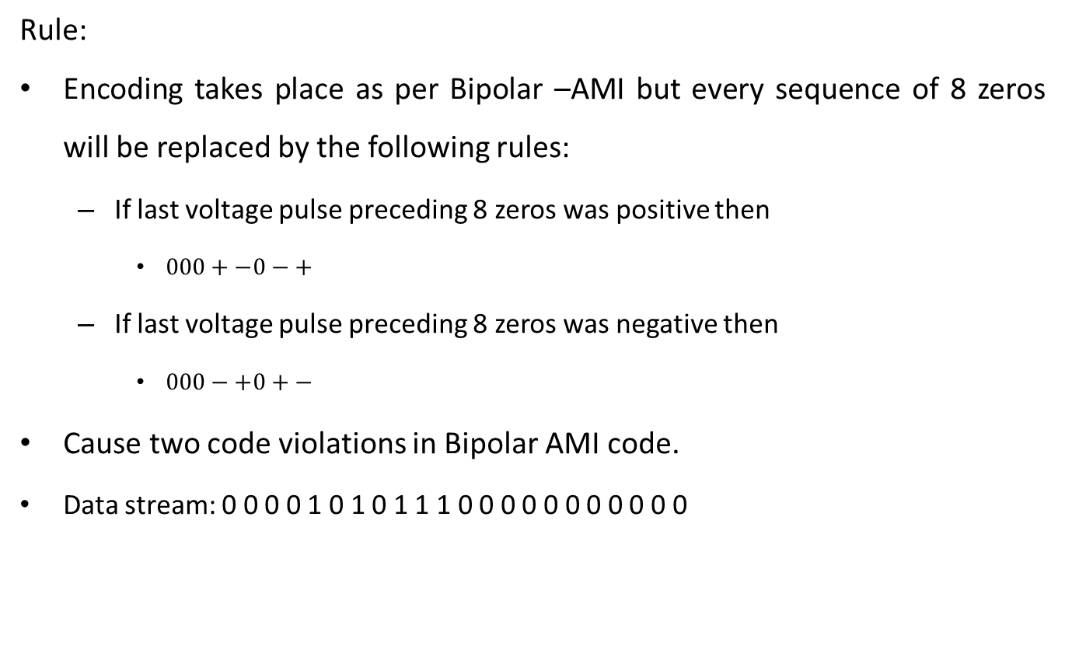
B8ZS
Rule:
Encoding takes place as per Bipolar –AMI but every sequence of 8 zeros will be replaced by the following rules:
If last voltage pulse preceding 8 zeros was positive then
$000+−0−+$
If last voltage pulse preceding 8 zeros was negative then
$000−+0+−$
Cause two code violations in Bipolar AMI code.
Data stream: 0 0 0 0 1 0 1 0 1 1 1 0 0 0 0 0 0 0 0 0 0 0

Slide 50
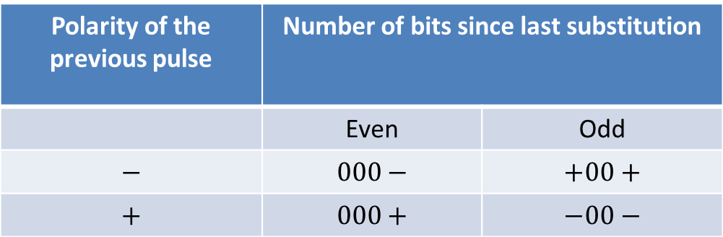
HDB3
Rule:
Encoding takes place as per Bipolar –AMI but every sequence of 4 zeros will be replaced by the following rules:
Cause one code violations in Bipolar AMI code.
Data stream: 0 0 0 0 1 0 1 0 1 1 1 0 0 0 0 0 0 0 0 0 0 0
Polarity of the previous pulse | Number of bits since last substitution
 | Even | Odd
$$−$$ | $$000−$$ | $$+00+$$
$$+$$ | $$000+$$ | $$−00−$$

Slide 51
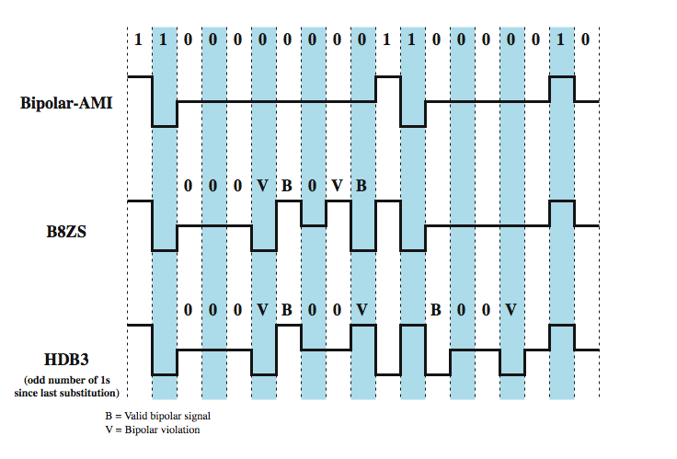
B8ZS and HDB3
Notes:
Two techniques are commonly used in long-distance transmission services; these are illustrated in Stallings DCC8e Figure 5.6.
A coding scheme that is commonly used in North America, based on a bipolar-AMI, is known as bipolar with 8-zeros substitution (B8ZS). To overcome the drawback of the AMI code that a long string of zeros may result in loss of synchronization, the encoding is amended with the following rules:
• If an octet of all zeros occurs and the last voltage pulse preceding this octet was positive, then the eight zeros of the octet are encoded as 000+–0–+.
• If an octet of all zeros occurs and the last voltage pulse preceding this octet was negative, then the eight zeros of the octet are encoded as 000–+0+–.
This technique forces two code violations (signal patterns not allowed in AMI) of the AMI code, an event unlikely to be caused by noise or other transmission impairment. The receiver recognizes the pattern and interprets the octet as consisting of all zeros.
A coding scheme that is commonly used in Europe and Japan is known as the high-density bipolar-3 zeros (HDB3) code. It is also based on the use of AMI encoding. In this case, the scheme replaces strings of four zeros with sequences containing one or two pulses. In each case, the fourth zero is replaced with a code violation. In addition, a rule is needed to ensure that successive violations are of alternate polarity so that no dc component is introduced. Thus, if the last violation was positive, this violation must be negative and vice versa.
Neither of these codes has a dc component. Most of the energy is concentrated in a relatively sharp spectrum around a frequency equal to one-half the data rate. Thus, these codes are well suited to high data rate transmission.

Slide 52
Block Encoding
4B/5B similarly 8B/10B
Rule
Every 4 bit data is encoded in 5 bit code.
5 bit codes are selected such that it do not have no more than one leading 0 and no more then two trailing 0s.
Therefore the code will never have three consecutive 0s.
Resulted code is transmitted using NRZI.
Provide 80% of bandwidth utilization.
8B/10B is used over Fibre Channel and Gigabit Ethernet etc.

Slide 53
Signal Modulation Criteria
The factor which determines how successful a receiver will be in interpreting an incoming signal depends on
Signal-to-noise ratio
Data rate
Bandwidth
An increase in data rate increases bit error rate.
An increase in SNR decreases bit error rate.
An increase in bandwidth allows an increase in data rate.

Slide 54
Basic Modulation Techniques
Digital data to analog signal
– Amplitude-shift keying (ASK)
• Amplitude difference of carrier frequency
– Frequency-shift keying (FSK)
• Frequency difference near carrier frequency
– Phase-shift keying (PSK)
• Phase of carrier signal shifted

Slide 55
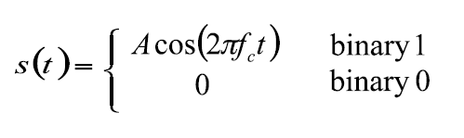
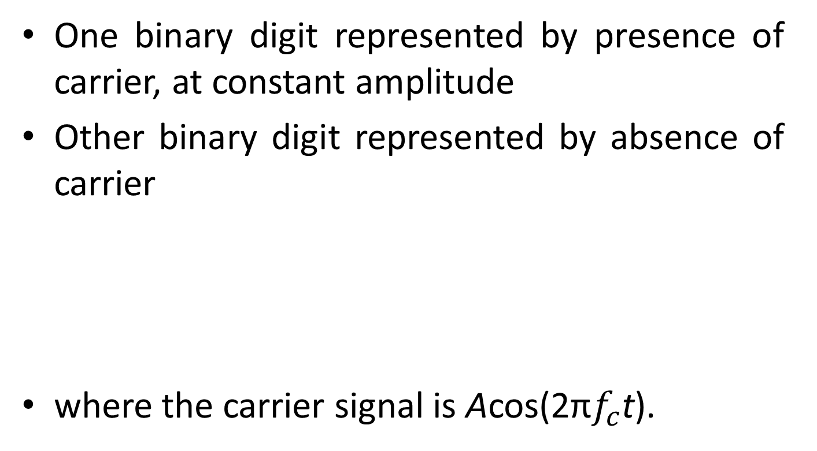
Amplitude-Shift Keying
One binary digit represented by presence of carrier, at constant amplitude
Other binary digit represented by absence of carrier
where the carrier signal is Acos(2π$f_{c}$t).

Slide 56
Amplitude-Shift Keying
Inefficient modulation technique
On voice-grade lines, used up to 1200 bps
Used to transmit digital data over optical fiber

Slide 57
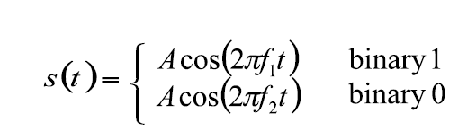
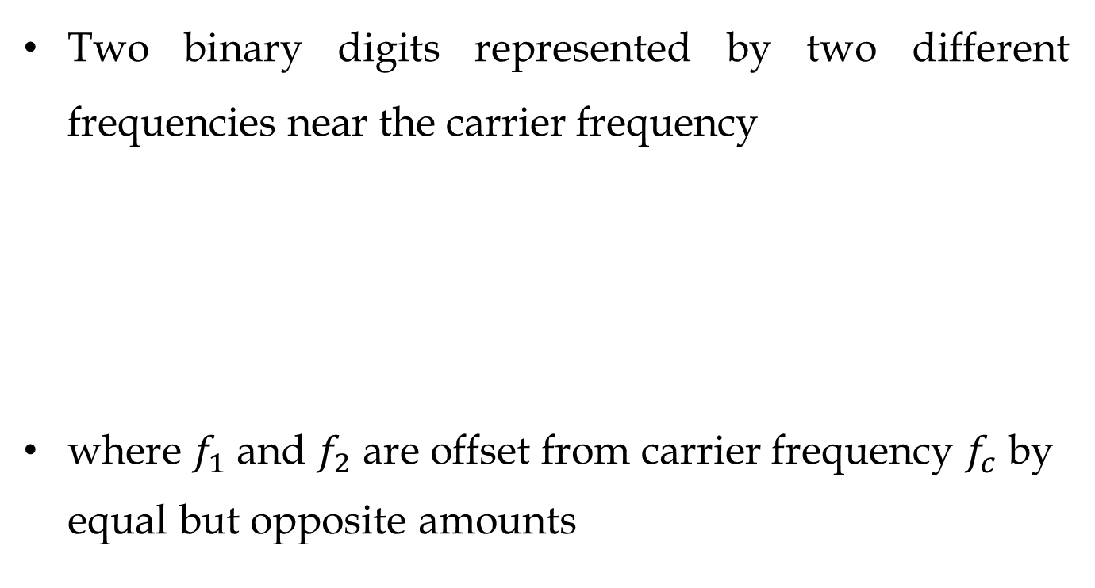
Frequency-Shift Keying
Two binary digits represented by two different frequencies near the carrier frequency
where $f_{1}$ and $f_{2}$ are offset from carrier frequency $f_{c}$ by equal but opposite amounts

Slide 58
Frequency-Shift Keying
Less susceptible to error than ASK.
On voice-grade lines, used up to 1200 bps
Used for high-frequency (3 to 30 MHz) radio transmission
Can be used at higher frequencies on LANs that use coaxial cable
Inefficient to utilize full channel capacity.

Slide 59

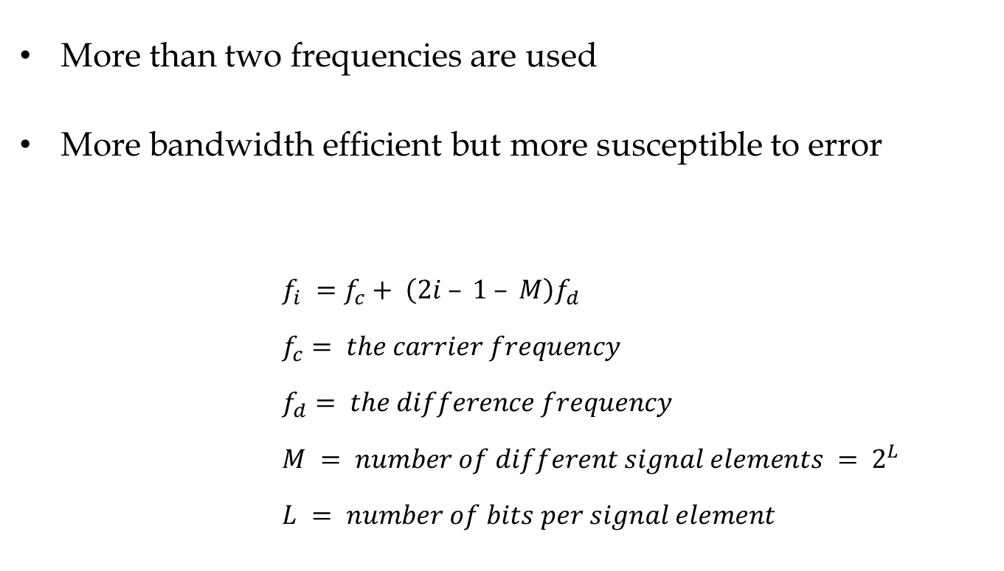
Multiple Frequency-Shift Keying
More than two frequencies are used
More bandwidth efficient but more susceptible to error
$$f_{i} =f_{c}+ \left(2i – 1 – M\right)f_{d}$$
$$f_{c}= the carrier frequency$$
$$f_{d}= the difference frequency$$
$$M = number of different signal elements = 2^{L}$$
$$L = number of bits per signal element$$

Slide 60
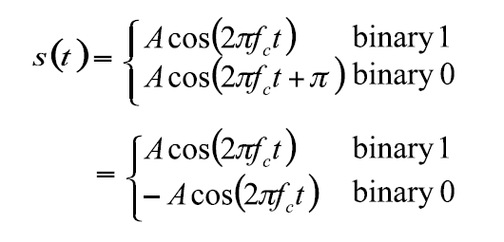
Phase-Shift Keying
Two-level PSK (BPSK)
– Uses two phases to represent binary digits

Slide 61
Differential PSK (DPSK)
Phase shift with reference to previous bit
Binary 0 – signal burst of same phase as previous signal burst
Binary 1 – signal burst of opposite phase to previous signal burst

Slide 62
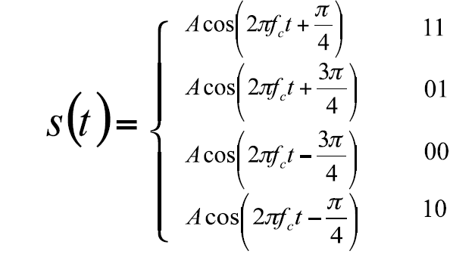
Four-level PSK (QPSK)
Each element represents more than one bit

Slide 63
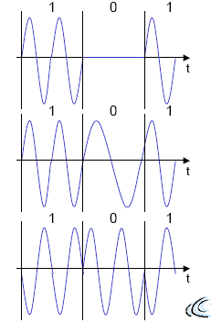
Example of ASK, FSK and PSK
ASK
FSK
PSK

Slide 64

Quadrature Amplitude Modulation
QAM is a combination of ASK and PSK
– Two different signals sent simultaneously on the same carrier frequency
Multiple amplitude and multiple phases are used in the signal to represent data.

Slide 65
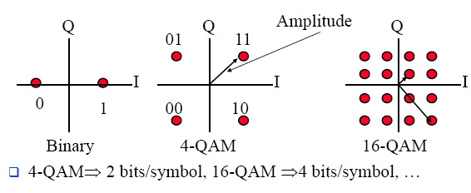
Quadrature Amplitude Modulation
It is possible to code n bits using one symbol
For example with 2 amplitude and 4 phases the scheme will be 8-QAM and so on like 16-QAM, 32-QAM, 64-QAM, 256-QAM…
Constellations Diagram

Slide 66
Multiple Shift Keying (MSK)
Bandwidth needed for FSK depends on the distance between the carrier frequencies.
Special pre-computation avoids sudden phase shifts → MSK (Minimum Shift Keying)
Bits are separated into even and odd bits, the duration of each bit is doubled.
Depending on the bit values (even, odd) the higher or lower frequency, original or inverted is chosen.
The frequency of one carrier is twice the frequency of the other. Equivalent to offset QPSK
Even higher bandwidth efficiency can be achieved using a Gaussian low-pass filter → GMSK (Gaussian MSK), used in GSM.

Slide 67
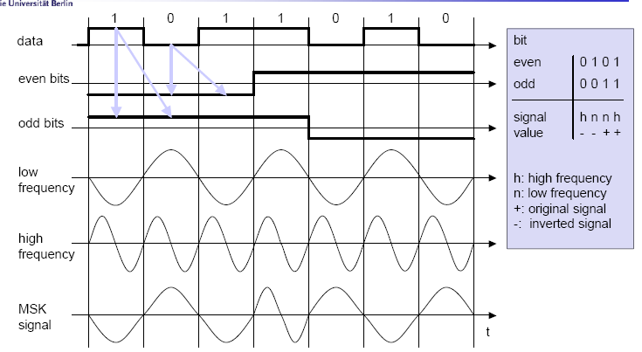
Example of MSK

Slide 68
Signal propagation
Propagation in free space always like light (straight line)
Receiving power proportional to 1/d² in vacuum
(d = distance between sender and receiver)
Receiving power additionally influenced by
Path loss / fading: Depends upon distance and frequency
shadowing : Obstructions
Réflexion at large obstacles
Refraction depending on the density of a medium
Scattering at small obstacles
Diffraction at edges
Noise
Frequency Dispersion (Doppler Spread) due to motion
Interference
Multipath: Multiple reflected waves: Inter-symbol interference (ISI) due to dispersion

Slide 69
Quadrature Amplitude Modulation
QAM used on asymmetric digital subscriber line (ADSL) and some wireless
combination of ASK and PSK
logical extension of QPSK
send two different signals simultaneously on same carrier frequency
use two copies of carrier, one shifted 90°
each carrier is ASK modulated
two independent signals over same medium
demodulate and combine for original binary output
Notes:
Quadrature amplitude modulation (QAM) is a popular analog signaling technique that is used in the asymmetric digital subscriber line (ADSL), described in Chapter 8, and in some wireless standards. This modulation technique is a combination of ASK and PSK. QAM can also be considered a logical extension of QPSK. QAM takes advantage of the fact that it is possible to send two different signals simultaneously on the same carrier frequency, by using two copies of the carrier frequency, one shifted by 90˚ with respect to the other. For QAM, each carrier is ASK modulated. The two independent signals are simultaneously transmitted over the same medium. At the receiver, the two signals are demodulated and the results combined to produce the original binary input.

